Slide 1
Database system
Saba Ghani
FAST-NU
Chiniot Faisalabad Campus

Slide 2
SELECT statement
A SELECT statement can consist up to six clauses.
SELECT [DISTINCT | ALL]
{* | [column_expression [AS new_name]] [,...] }
FROM table_name [alias] [, ...]
[WHERE condition]
[GROUP BY column_list]
[HAVING condition]
[ORDER By column_list]
Only SELECT and FROM clauses are mandatory.
Order of the clauses cannot be changed.

Slide 3
Selecting computed columns
Actual table
Car_sales
City
Year
cars_sold
Dhahran
2001
525
Dhahran
2002
456
Riyadh
2001
700
Riyadh
2002
654
Jeddah
2001
921
Jeddah
2002
752
Khobar
2002
0

Slide 4
Selecting computed columns
Actual table
City
Year
cars_sold
Dhahran
2001
525
Dhahran
2002
456
Riyadh
2001
700
Example:
SELECT
city
,year
,cars_sold As Sold
,cars_sold * 100000 AS sales
FROM car_sales;
Riyadh
2002
654
City
Year
Sold
sales
Jeddah
2001
921
Dhahran
2001
525
52500000
Jeddah
2002
752
Dhahran
2002
456
45600000
Khobar
2002
0
Riyadh
2001
700
70000000
Riyadh
2002
654
65400000
Jeddah
2001
921
92100000
Jeddah
2002
752
75200000
Khobar
2002
0
0

Slide 5
SQL Clause
DISTINCT CLAUSE:
If a query includes the primary key of a table in its select list, then every row of query results will be unique.
If the primary key is not included in the query results, duplicate rows can occur.

Slide 6
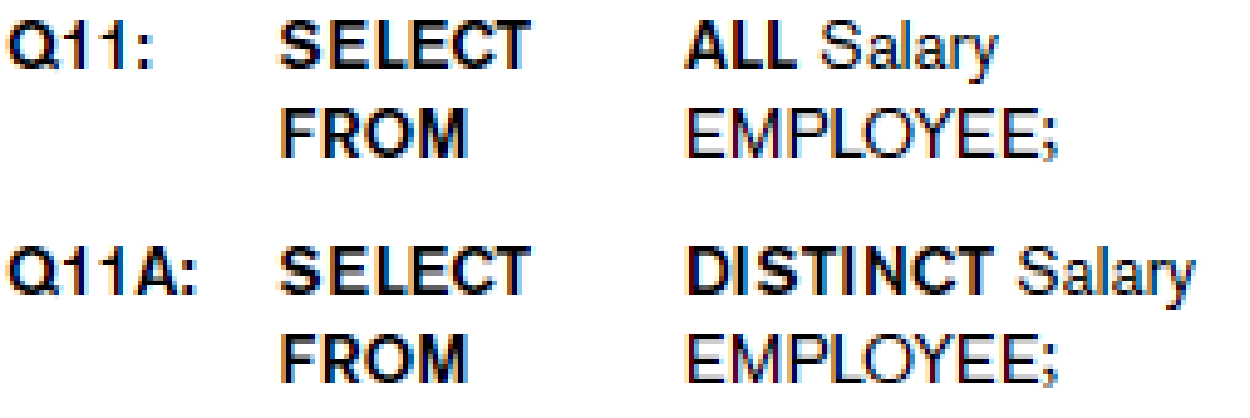
SQL Clause
The DISTINCT keyword can be used to return only distinct (different) values.
Syntax SELECT DISTINCT column_name FROM table_name;
SELCET DISTINCT MGR FROM OFFICE; MGR ------------- 104 105 106 108

Slide 7
SQL Predicates
Different types of predicates are used to retrieve data from tables these are
BETWEEN
IN
NOT IN
LIKE
EXIST
NOT EXIST
IS NULL
NOT NULL
Order by
Group by
Having

Slide 8
Special Operators
BETWEEN
Used to check whether attribute value is within a range
Syntax SELECT Columnlist FROM TABLE-Name WHERE Column name BETWEEN(VALUE1 AND VALUE2);
EXAMPLE SELECT * FROM EMPLOYEE WHERE salary>25000 AND salary<55000;
OR
SELECT * FROM EMPLOYEE WHERE salary BETWEEN 25000 AND 55000;

Slide 9
Special Operators
IS NULL
Used to check whether attribute value is null
Example SELECT Fname,LName,Address, salary FROM EMPLOYEE WHERE Address IS NULL;

Slide 10
Special Operators
Wild CARD Character
In SQL, wildcard characters are used with the SQL LIKE operator
SQL wildcards are used to search for data within a table
% substitute for zero or more characters
_ substitute for a single character
LIKE
Used to check whether attribute value matches given string pattern
'%dd%' means a sequence of characters of any length containing ‘dd'.
SYNTAX SELECT COLUMN-NAME(S) FROM TABLE NAME LIKE COLUMN NAME PATTREN;
EXAMPLE SELECT Fname, Lname,Bdate, salary FROM EMPLOYEE where Address LIKE S%;

Slide 11
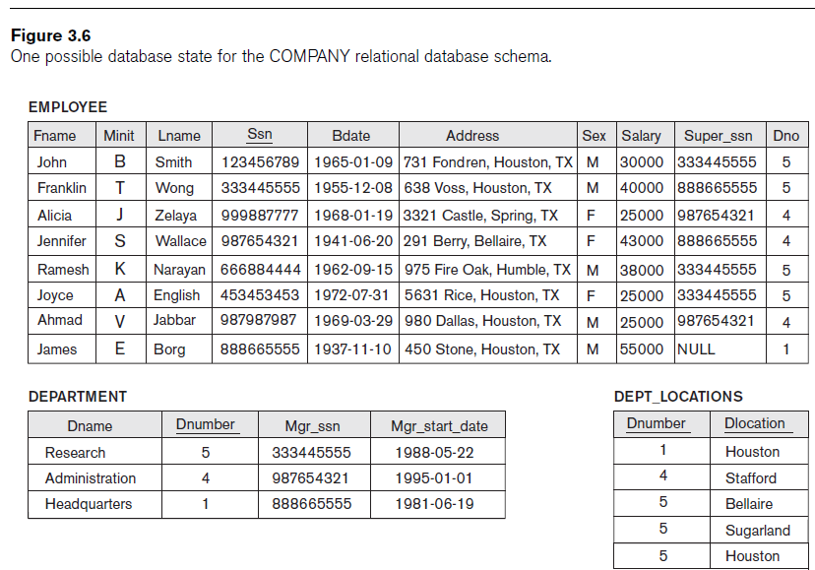
Special Operators
IN
Used to check whether attribute value matches any value within a value list
Syntax SELECT column_name(s) FROM table_name WHERE column_name IN (value1,value2,...);
Example SELECT * FROM EMPLOYEE WHERE salary IN(25000,40000);
NOT IN
Selecting all the records whose column value not a member of the set specified in the WHERE clause.
Example SELECT * FROM EMPLOYEE WHERE salary NOT IN(25000,40000);

Slide 12
ORDER BY CLAUSE
The ORDER BY keyword is used to sort the result-set by one or more columns
Keyword DESC to see result in a descending order of values
Keyword ASC to specify ascending order explicitly
SELECT * FROM EMPLOYEE ORDER BY ADDRESS ASC, Fname DESC;
SELECT CITY, REGION FROM OFFICES ORDER BY REGION ASC;

Slide 13
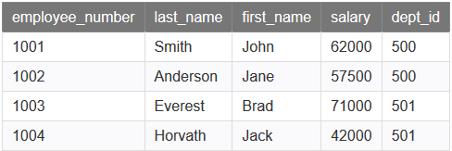

GROUP BY CLAUSE
The SQL GROUP BY clause is used in collaboration with the SELECT statement to arrange identical data into groups.
SYNTAX SELECT column1, column2 FROM table_name WHERE [ conditions ] GROUP BY column1, column2
EXAMPLE SELECT dept_id, SUM(salary) AS total_salaries FROM employees GROUP BY dept_id;

Slide 14
HAVING CLAUSE
The SQL HAVING clause is used in combination with the GROUP BY clause to restrict the groups of returned rows to only those whose the condition is TRUE.
Similar to WHERE, but WHERE filters individual rows whereas HAVING filters groups.
SELECT department, SUM(sales) AS "Total sales" FROM order_details GROUP BY dno HAVING SUM(sales) > 1000;
SELECT DEPARTMENT, MIN(salary) AS "Lowest salary" FROM EMPLOYEE GROUP BY Dnumber HAVING MIN(salary) > 35000;
SELECT DEPARTMENT, MAX(salary) AS "Highest salary" FROM EMPLOYEE GROUP BY Dnumber HAVING MAX(salary) < 50000;

Slide 15
Aggregation Function
ISO standard defines five aggregate functions:
COUNT returns number of values in a specified column.
SUM returns sum of values in a specified column.
AVG returns average of values in a specified column.
MIN returns smallest value in a specified column.
MAX returns largest value in a specified column.

Slide 16
Aggregation Function rules
Each operates on a single column of a table and return single value.
COUNT, MIN, and MAX apply to numeric and non-numeric fields
SUM and AVG may be used on numeric fields only
Can use DISTINCT before column name to eliminate duplicates.
DISTINCT has no effect with MIN/MAX, but may have with SUM/AVG.
Aggregate functions can be used only in SELECT list and in HAVING clause.
SELECT city, COUNT(*) as rows
FROM car_sales;

Slide 17
Aggregation Function
How many rows are there in the car_sales table?
How many cities are there in the car_sales table?
City
Year
Cars_Sold
SELECT
COUNT(DISTINCT city)
as city
FROM car_sales
Dhahran
2001
525
SELECT COUNT(*) as Rows
FROM car_sales
Dhahran
2002
456
Jeddah
2001
921
Jeddah
2002
752
Rows
city
Khobar
2002
7
4
Riyadh
2001
700
Riyadh
2002
654

Slide 18
SUM Function
Find the total number of all the cars sold from the car_sales table?
Find the number of all the cars_sold in Dhahran from the car_sales table?
City
Year
Cars_Sold
SELECT
SUM(cars_sold) as cars_sold
FROM car_sales
SELECT
SUM(cars_sold) as Dah_cars
FROM car_sales
WHERE city = ‘Dhahran’
Dhahran
2001
525
Dhahran
2002
456
Jeddah
2001
921
Jeddah
2002
752
Cars_sold
Dah_cars
Khobar
2002
4008
981
Riyadh
2001
700
Riyadh
2002
654

Slide 19
MIN,MAX and AVG function
Find the minimum, maximum, and average cars_sold per year form the car_sales table
SELECT MIN(cars_sold) as Min_sold
, MAX(cars_sold) as Max_sold
, AVG(cars_sold) as Avg_sold
FROM car_sales
WHERE car_sales IS NOT NULL;
Min_sold
Max_sold
Avg_sold
456
921
668

